Slide 1

Exercise 5 point 1
Badea Dan-Nicolai

Slide 2
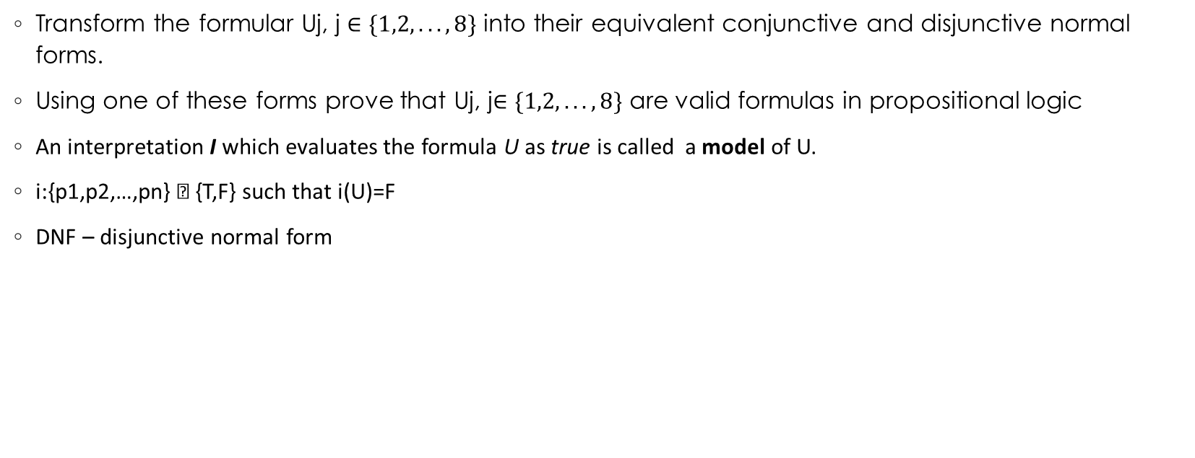
Exercise 5
Transform the formular Uj, j $∈\{1,2,...,8\}$ into their equivalent conjunctive and disjunctive normal forms.
Using one of these forms prove that Uj, j$∈\{1,2,...,8\}$ are valid formulas in propositional logic
An interpretation I which evaluates the formula U as true is called a model of U.​
i:{p1,p2,…,pn} → {T,F} such that i(U)=F​
DNF – disjunctive normal form​

Slide 3
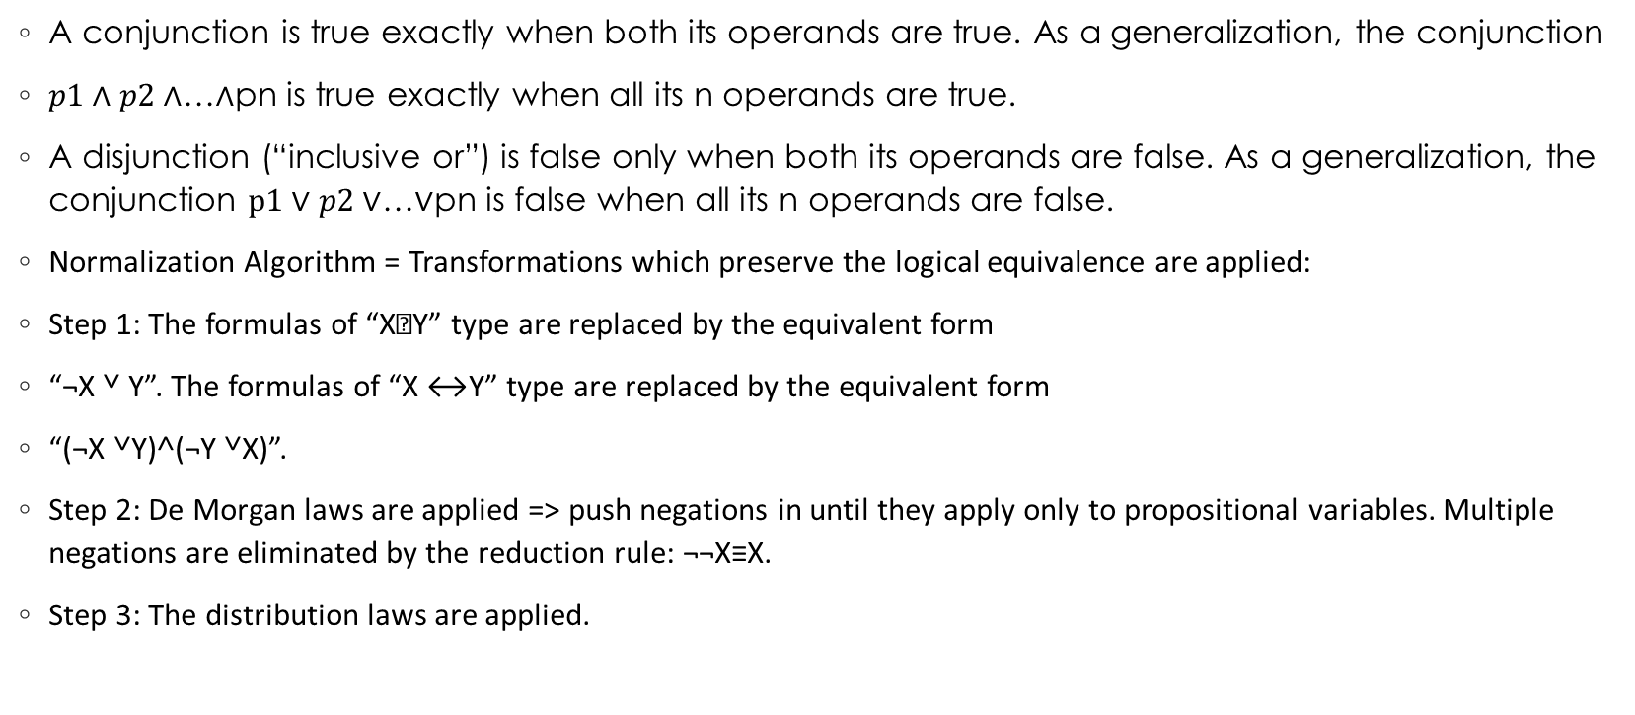
Theory
A conjunction is true exactly when both its operands are true. As a generalization, the conjunction
$p1∧p2∧$…$∧$pn is true exactly when all its n operands are true.
A disjunction (“inclusive or”) is false only when both its operands are false. As a generalization, the conjunction $p1∨p2∨$…$∨$pn is false when all its n operands are false.
Normalization Algorithm = Transformations which preserve the logical equivalence are applied:​
Step 1: The formulas of “X→Y” type are replaced by the equivalent form ​
“¬X ˅ Y”. The formulas of “X ↔Y” type are replaced by the equivalent form ​
“(¬X ˅Y)˄(¬Y ˅X)”.​
Step 2: De Morgan laws are applied => push negations in until they apply only to propositional variables. Multiple negations are eliminated by the reduction rule: ¬¬X≡X.​
Step 3: The distribution laws are applied.​

Slide 4

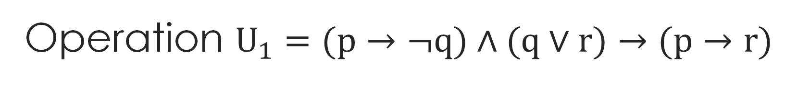
Operation $U_{1}=(p→¬q)∧(q∨r)→(p→r)$
$\left(p→¬q\right)∧\left(q∨r\right)→\left(p→r\right)$
$\left((p→¬q\right)∧\left(q∨r\right))→\left(p→r\right)$
$¬ \left((p→¬q\right)∧\left(q∨r\right))∨\left(p→r\right)$
$¬$ $\left(p→¬q\right)$ $∨$ $¬ \left(q∨r\right)$ $∨\left(p→r\right)$
$¬$ $\left(p→¬q\right)$ $∨$ $\left(¬q\text{˄}¬r\right)$ $∨\left(p→r\right)$
$¬$ $\left(¬p v ¬q\right) ∨$ $\left(¬q\text{˄}¬r\right)$ $∨\left(p→r\right)$
$¬ \left(¬p v ¬q\right)$ $∨$ $\left(¬q∧¬r\right)$ $∨\left(p→r\right)$
$¬ \left(¬p v ¬q\right)$ $∨$ $\left(¬q∧¬r\right)$ $∨¬\left(p∧¬r\right)$
(p ^ q) v ($¬q∧$ $¬$r) v ($¬$p v r)

Slide 5

Distribution
(p ^ q) v ($¬q∧$ $¬$r) v $¬$p v r
(p v $¬q$ v $¬$p v r) ^ (p V $¬r$ V$¬$p v r) ^(q V $¬q$ V$¬$p v r) ^ (q V $¬r$ V$¬$p v r)
T ^ T ^ T ^ T = T

